Slide 1
While loops, For loops
Andrew Beatty
Andrew.Beatty@gmit.ie
Programming and Scripting
P 4.2

Slide 2
Structured programming theorem
Executing one subprogram, and then another subprogram (sequence)
Executing one of two subprograms according to the value of a boolean expression (selection)
Repeatedly executing a subprogram as long as a boolean expression is true (iteration)

Slide 3
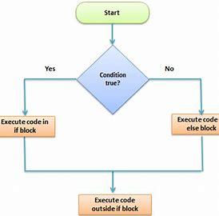
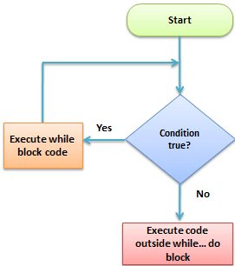

normal
If else
While loop
Or
For Loop
start
Statement 1
Statement 2
Statement 3

Slide 4
While
Basic format
while condition:
statements

Slide 5
Counter controlled vs sentinel controlled
Counter controlled loop
When making while loops there are three parts you need
Initialise condition variables
Check condition
Change condition variables
Sentinal controlled loop
When making while loops there are three parts you need
Initialise condition variables
Check condition
Change condition variables
count = 0
while count < 10:
#do something
count += 1
val = input(“type some (q to quit):")
while val != 'q':
#do something
val = input ("(q to quit):")

Slide 6
For loops
Used a lot with lists
format
for elem in list:
statements
for number in range(1,10):
statements

Slide 7
Stand up
and clean the kitchen table

